Slide 1
Attention in Psychology: I Historical Background
Attention was one of the first concepts to appear in Psychology texts (ca 1730) – e.g., Ebbinghaus, Titchener, …
Early discussions (Hatfield, 1998) focused on properties such as
  Narrowing (Aristotle, 4th century BC)
  Active Directing (Lucretius, 1st century AD)
  Involuntary shifts (Hippo, 400 AD)
  Clarity (Buridan, 14th century)
  Fixation over time (Descartes, 17th century)
  Effector sensitivity (Descartes)
  All the above phenomena (William James, early 1900s)
More recent studies have been concerned with
  The view of attention as selection
  The analysis of attention as a process of resource allocation
  The study of the relation between voluntary and involuntary control of attention

Slide 2
Attention as Selection
■
Selection or Filtering aspects of attention.
1. Why do we need to select anyway?
  Because our processing capacity is limited?
  In what way is it limited? (Miller, 1957)
    attention as selection and the filter theory.
On what basis do we select? Some alternatives:
  We select according to what is important to us (e.g., affordances)
  We select what can be described physically (i.e., “channels”)
  We select based on what can be encoded without accessing LTM
  We “pick out” things to which we subsequently attach concepts: i.e., we pick out objects (or regions?)
What happens to what we have not selected?

Slide 3
Why do we need to select information?
■
Along which dimensions is human information processing capacity limited?
Channel capacity: Shannon-Hartley Theorem
Capacity measured in some sort of “chunks” (Miller)

Slide 4
Early studies: Colin Cherry’s “Cocktail Party Problem”
What determines how well you can select one conversation among several? Why are we so good at it?
The more controlled version of this study used dichotic presentations – one “channel” per ear.
Cherry found that when attention is fully occupied in selecting information from one ear (through use of the “shadowing” task), almost nothing is noticed in the “rejected” ear (only if it was not speech).
More careful observations shows this was not quite true
  Change in spectral properties (pitch) is noticed
  You are likely to notice your name spoken
  Even meaning is extracted, as shown by involuntary ear switching and disambiguating effect of rejected channel content

Slide 5
Broadbent’s Filter Theory
Rehearsal loop
Effectors
Motor planner
Senses
Filter
Very Short Term Store
Limited Capacity Channel
Store of conditional probabilities of past events (in LTM)
Broadbent, D. E. (1958). Perception and Communication. London: Pergamon Press.

Slide 6
Stroop Effect
Baseline: Name the colors of the ink


Slide 7
Stroop Effect in Portuguese
Name the colors of the ink
VERMELHO VERDE AZUL MARROM ROSA ALARANJADO VERDE ROSA VERMELHO AMARELO VERDE AMARELO VERMELHO MARROM VERMELHO AZUL MARROM VERDE VERMELHO ALARANJADO VERMELHO AZUL AMARELO ROSA ALARANJADO VERDE AZUL MARROM ROSA VERMELHO AMARELO VERDE AMARELO VERMELHO MARROM ROSA VERMELHO AMARELO VERDE AMARELO VERMELHO ROSA ALARANJADO VERDE AZUL MARROM ROSA VERMELHO AMARELO VERDE AMARELO VERMELHO BROWN VERMELHO AZUL MARROM VERDE AMARELO VERDE AMARELO VERMELHO ROSA ALARANJADO VERDE VERMELHO AZUL MARROM VERDE VERMELHO ALARANJADO VERMELHO AZUL

Slide 8
Stroop Effect in English
Name the colors of the ink
RED GREEN BLUE PINK BROWN ORANGE GREEN PINK RED YELLOW GREEN YELLOW RED BROWN RED BLUE BROWN GREEN RED ORANGE RED BLUE YELLOW PINK ORANGE GREEN BLUE BROWN PINK RED YELLOW GREEN YELLOW RED BROWN PINK RED YELLOW GREEN YELLOW RED PINK ORANGE GREEN BLUE BROWN PINK RED YELLOW GREEN YELLOW RED BROWN RED BLUE GREEN BROWN YELLOW GREEN YELLOW RED PINK ORANGE GREEN RED BLUE BROWN GREEN RED ORANGE RED BLUE YELLOW YELLOW GREEN YELLOW RED BROWN PINK RED YELLOW GREEN PINK RED YELLOW

Slide 9
What does visual attention select? (What are the bases for selection?)
  We can select places by moving our eyes so our gaze lands on different places.
  How does attention switch from one place to another? Studies of Covert Attention-Movement: Posner (1980).
  Is it always the case that we attend to places? Can we attend to any other property? Can we select on the basis of color, depth, spatial frequency, affordances, or the property a painting has of having been painted by Da Vinci
  Inattentional blindness
  Rapid visual search

Slide 10
Serial vs parallel search?
Finding an object that differs from all others in a scene by a single feature – called a single-feature search – is fast, error-free and almost independent of how many nontargets there are;
Finding an object that differs from all others by a conjunction of two or more features (and that shares at least one feature with each object in the scene) – called a conjunction search – is usually slow, error-prone, and is worse the more nontargets there are in the scene*.
These results suggest that in order to find a conjunction, which requires solving the binding problem, attention has to be scanned serially to all objects.
* This way of putting is simplifies things. Under certain
conditions the serial-parallel distinction breaks down

Slide 11
The attention-as-glue hypothesis has a converse: In addition to requiring attention to recognize objects
Attention is primarily directed at Objects
Instead of being like a spotlight beam that can be scanned around a scene and can be zoomed to cover a larger or smaller area, perhaps attention can only be directed towards occupied places – i.e., to visual objects. (This is compatible with both kinds of attention allocation occurring).

Slide 12
“Objects” endure over time
Several studies have shown that what counts as an object (as the same object) endures over time and over changes in location;
  Certain forms of disappearances in time and changes in location preserve objecthood.
This gives what we have been calling a “visual object” a real physical-object character and partly justifies our calling it an “object”.

Slide 13
Inhibition of return appears to be object-based (as well as location-based)
Inhibition-of-return is the phenomenon whereby an object that has been attended (and then attention is moved away from it) is less likely to attract attention again in a period of 300 ms to 900 ms after it is first attended. The attended item is said to be inhibited.
  This is thought to help in visual search since it prevents previously visited objects from being revisited

Slide 14
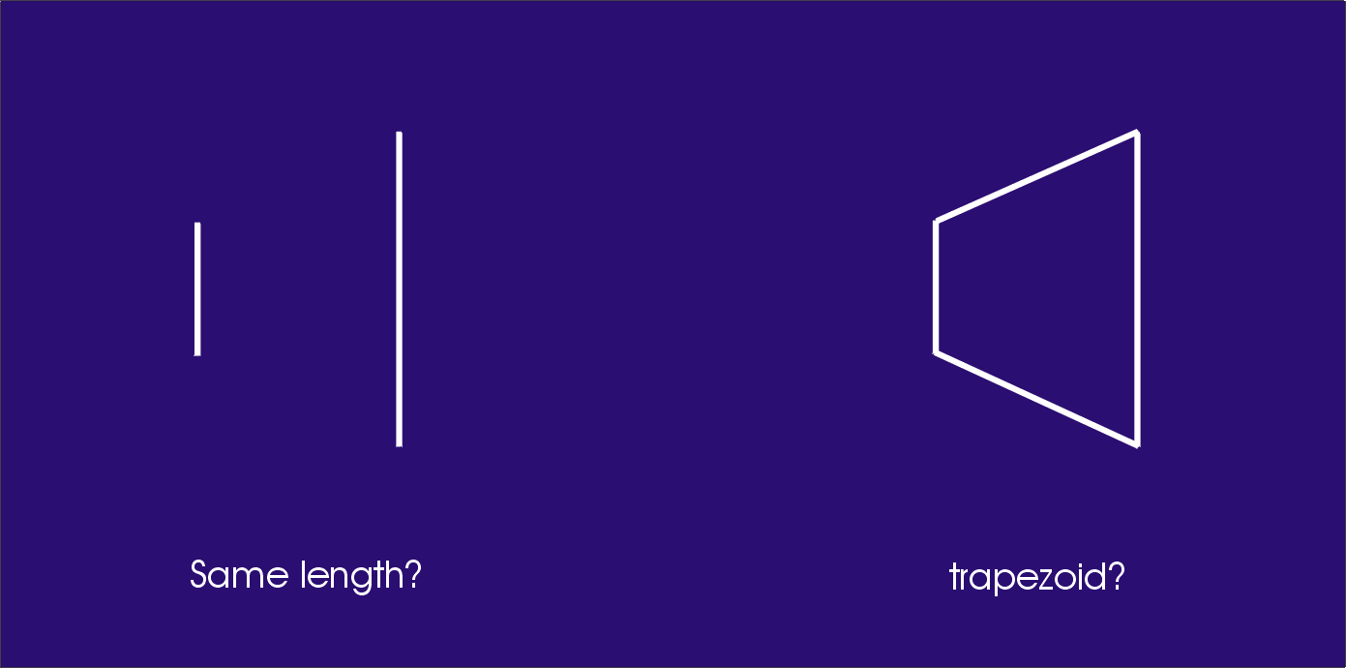
Simultanagnosic (Balint Syndrome) patients only attend to one object at a time
Simultanagnosic patients cannot judge the relative length of two
lines, but they can tell that a figure made by connecting the ends
of the lines is not a rectangle but a trapezoid (Holmes & Horax, 1919).

Slide 15

Balint patients can only attend to one object at a time even if they are overlapping
Luria, 1959

Slide 16
Information processing capacity appears to be limited to 7 ± 2 “chunks” rather than to a number of bits or baud
Experiments on “short term memory” STM (or “working memory”)
  Miller, G. A. (1956). The magical number seven, plus or minus two: Some limits on our capacity for processing information. Psychological Review, 63, 81-97.

Slide 17
Studies of the capacity of Visual Working Memory (Luck & Vogel, 1997)
People appear to be able to retain about 4 properties of an object (4 colors, 4 shapes, 4 orientations, etc) over a short time
People can also retain the identity of 4 objects for a short time.
Luck and Vogel found that as long as there are not more than 4 properties per object, people can retain large numbers of properties (a phenomenon that is reminiscent of Miller’s “chunking hypothesis” except the chunks are objects).

